Slide 1
Audio Feature Extraction
Overview on Common Techniques

Slide 2
Intro
For training any statistical or ML Model, data needs to be first pre-processed and brought into useful format.
Specifically talking about audio signals, these signals undergo basic signal processing steps of noise removal and proper conversion of analog form to digital samples for further computation.
Today, we will be focusing on the later steps of extracting meaningful information out these audio samples to recognise patterns

Slide 3
Various aspects of
Classification
Level of abstraction
(High Level, Mid Level, Low Level)
Temporal Scope
(Instantaneous, Segment Level, Global)
Musical Aspect
(beat, timbre, pitch, harmony, melody)
Signal Domain
(Time, Frequency, Time-Frequency)
ML Approach
(Traditional approach, DL approach)
They give broader view on what to select as per the problem statement given.
Different features capture different aspects of sound.

Slide 4
Level of Abstraction
High Level :
Human understandable and a way how any audio instruments are encoded.
Includes keys, chords, melody, rhythm, tempo, lyrics, genre mood, etc.
Mid Level
Ways of how humans perceive the audio.
Includes Pitch, beat-based descriptors such as note onsets, fluctuation patterns, MFCCs.
Low Level:
Not perceivable to humans
Includes amplitude envelope, energy, spectral centroid, zero-crossing rate.

Slide 5
Temporal Scope
Instantaneous :
Analysis on very short chunks (~50ms) of audio signal
Segment Level :
Aggregating instantaneous level feature for more duration (seconds).
Global
Only one descriptor for whole duration of sound. Aggregation of whole signal.

Slide 6
Musical Aspects
Loudness: perceived strength of sound; e.g., energy
Pitch: frequency, psychoacoustic ordering of tones (on scale; from low to high); e.g., chroma-features
Timbre: “tone color”, what distinguishes two sounds with same pitch and loudness; e.g., MFCCs
Chords and harmony: simultaneous pitches
Rhythm: pattern in time; e.g., FPs
Melody: sequence of tones; combination of pitch and rhythm

Slide 7
Signal Domain Aspect
Time Domain: Extracted from waveforms of the raw audio.
Eg. Zero crossing rate, amplitude envelope, and RMS energy
Frequency Domain: Focuses on the frequency components of the audio signal.
Eg. Band energy ratio, spectral centroid, and spectral spread
Time-Frequency Representation: Combines both the time and frequency components of the audio signal.
Eg. Spectrogram, mel-spectrogram, and MFCCs

Slide 8
ML Aspect
Traditional Approach: Looking upon all possible time & frequency domain features and handpicking ones that best solves the problem.
Deep Learning: A general way of extracting features from unstructured audio data.
Features identified by neural networks for which some level of preprocessing is required
eg. getting first the spectrograms of audio data and then passing them to neural nets for training.

Slide 9
Computing above discussed features and overview on their use cases

Slide 10
Feature extraction pipelines
Analog
Digital
Framing
Feature Value/
Matrix
Aggregation
(mean, median, GMM)
Feature computation
on each Frame
Time Domain
Analog
Digital
Framing
Windowing
Feature Value/
Matrix
Aggregation
Feature
Computation
FFT
Frequency Domain

Slide 11
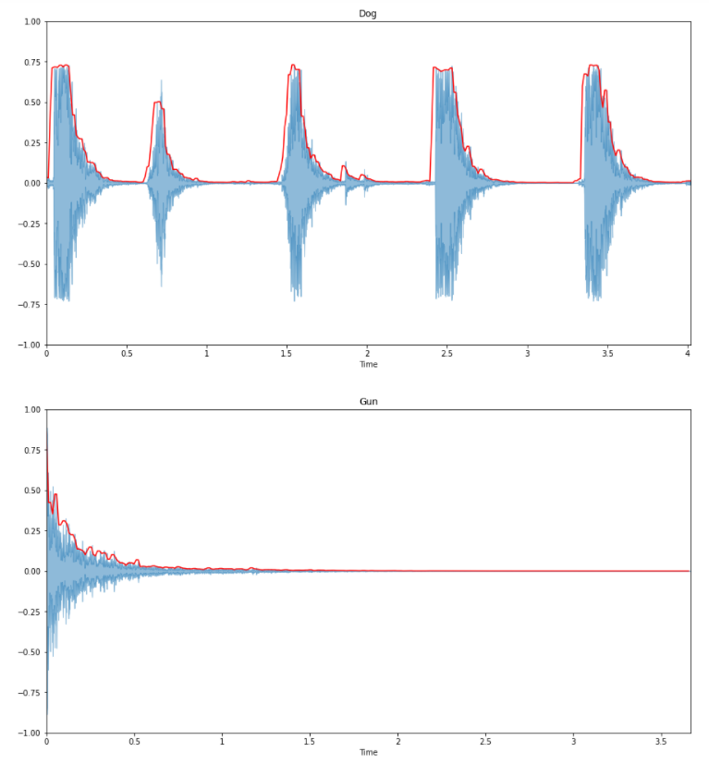
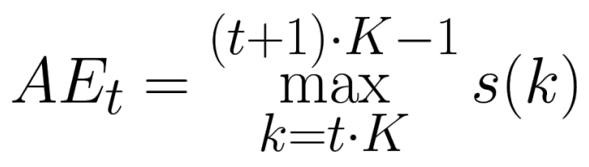
Time Domain Features
Amplitude Envelope
Max amplitude of all samples in a frame
Gives idea about loudness
But has issue of sensitivity w.r.t outliers in samples, traces unwanted spikes in signal

Slide 12
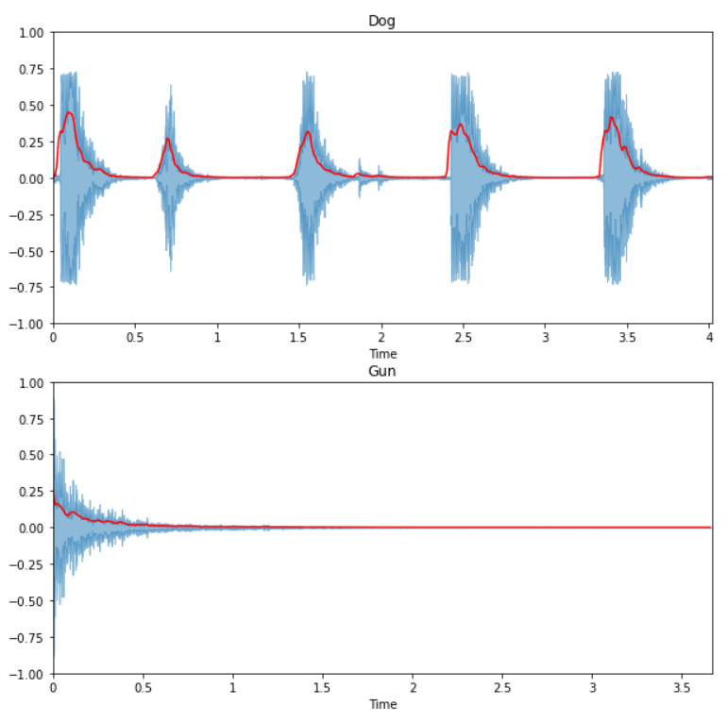
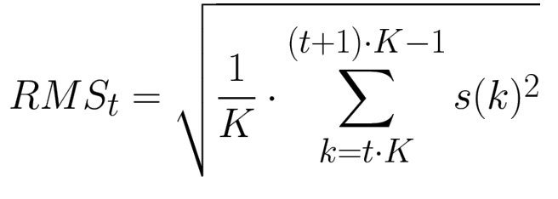
Time Domain Features
2. Root Mean Square Energy
RMS of all samples in a frame
Also an indicator of loudness
Less sensitive to outliers

Slide 13
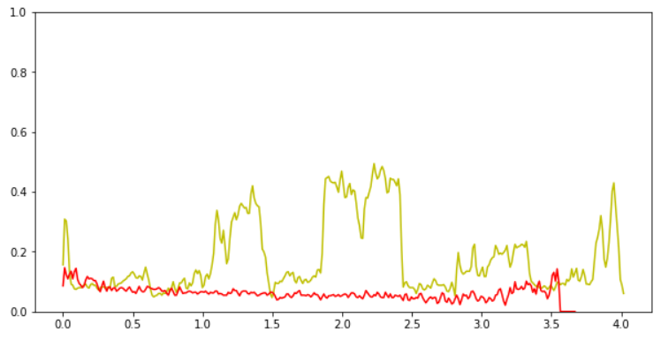
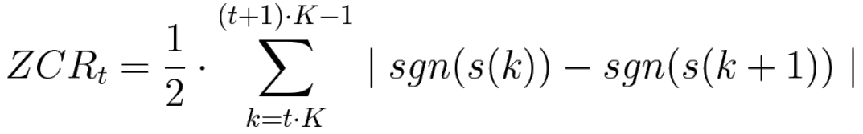
Time Domain Features
3. Zero Crossing Rate
# of times signal crosses the horizontal axis
Percussive vs pitched sounds
High ZCR -> High Pitch
Voiced Signals -> Lower ZCR, Unvoiced Signals -> Higher ZCR

Slide 14
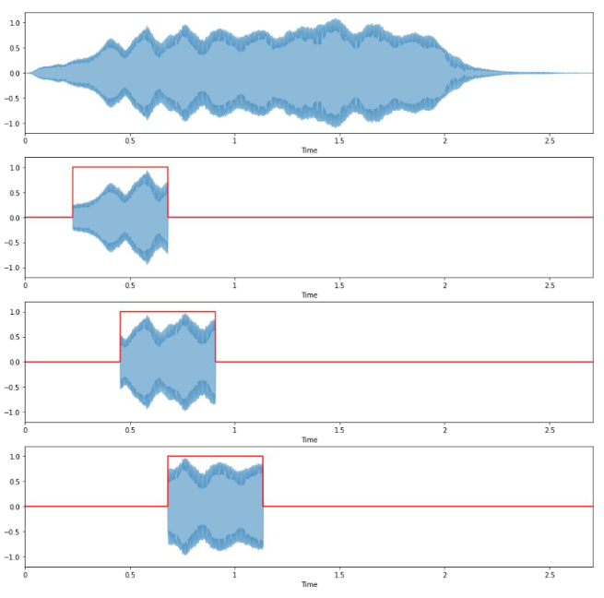
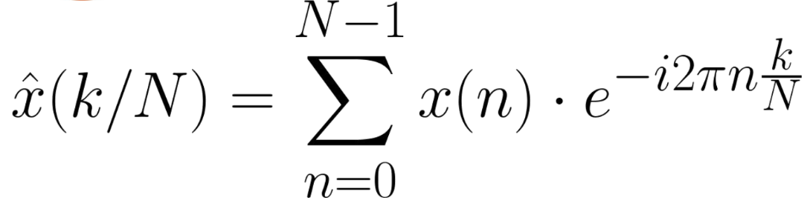
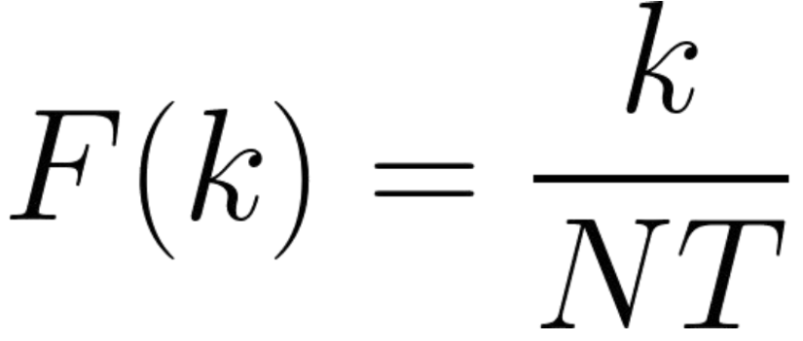
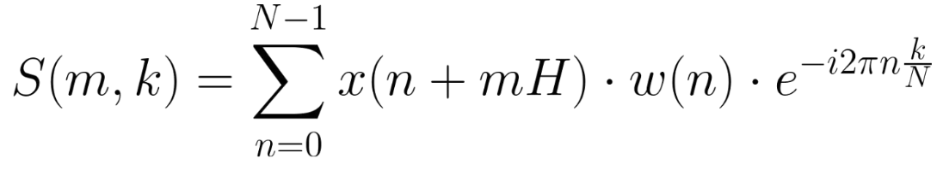
DFT to STFT
DFT tells about frequencies present in whole signal, what we want is spectrum information over various intervals of time.
K : 0 to N-1
H : Hop Length
N : All samples in Frame

Slide 15
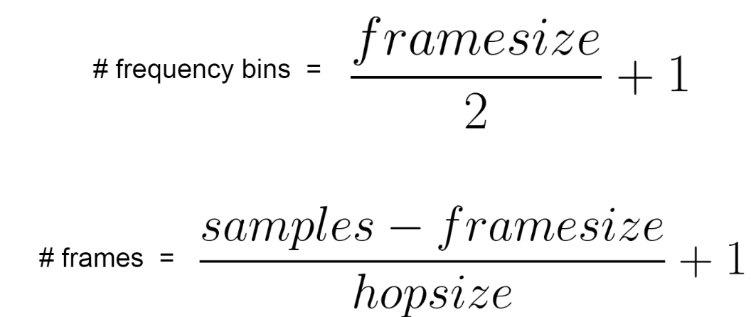
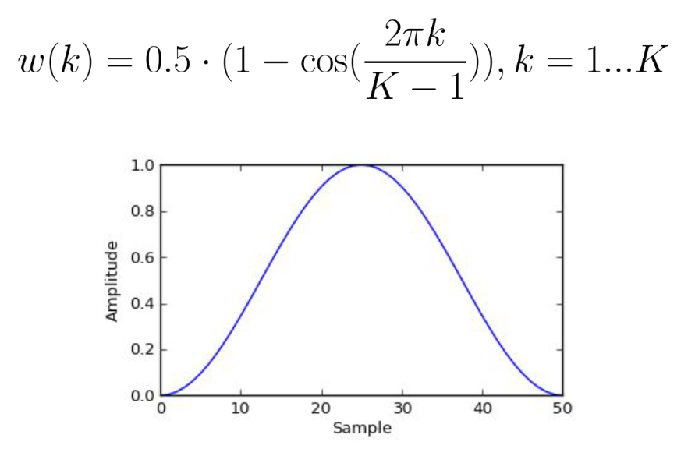
STFT Contd.
Frame size should be decided based in the application problem
Frame size → frequency resolution → 1/(time resolution)
STFT Output → Matrix(#freq. Bins X #frames)

Slide 16
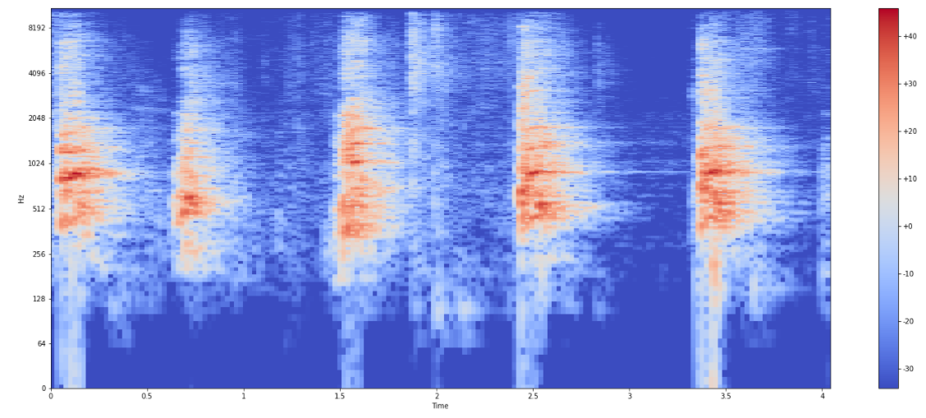
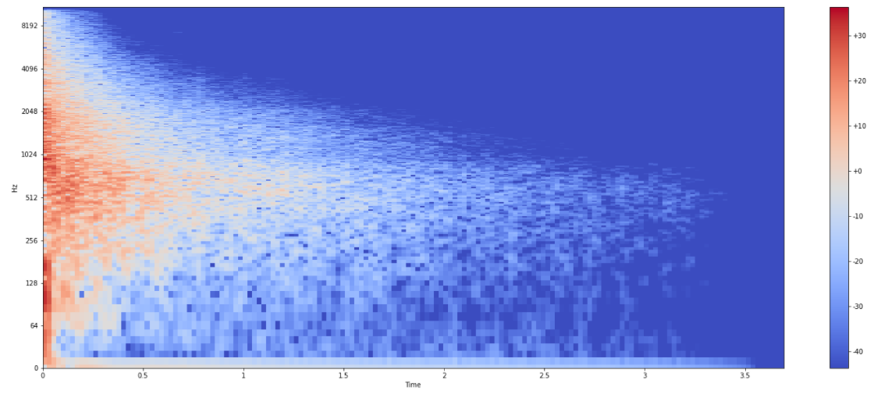
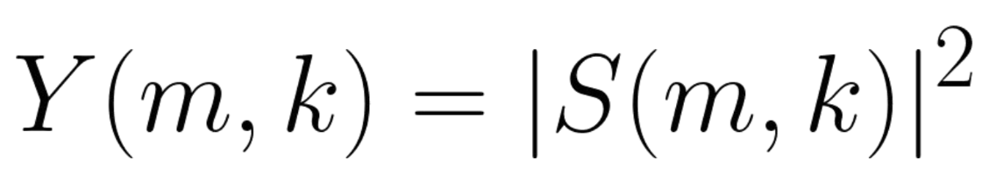
Spectral Features
4. Spectrograms
Heat map visualization for any sound
Humans perceive logarithmically hence for better capturing of information apply log on intensities and frequencies.

Slide 17
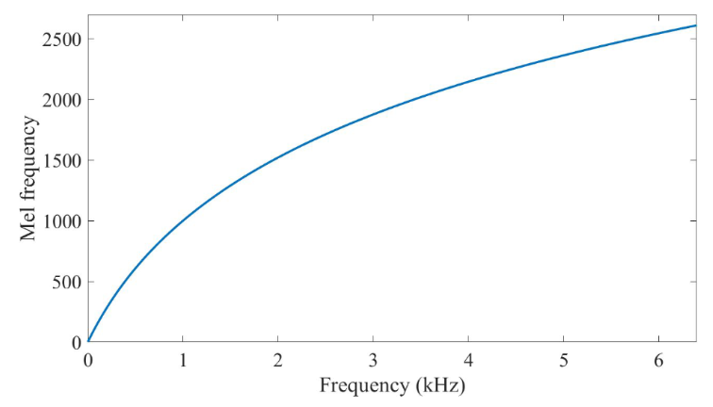
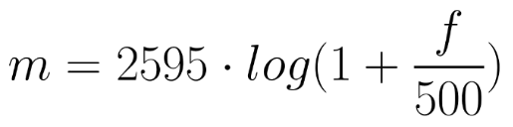
Spectral Features
5. Mel-Spectrograms
Vanilla Spectrograms doesn’t consider perceptually relevant frequency representation
Equal distances on mel scale have same perceptual distance
Mel Scale

Slide 18
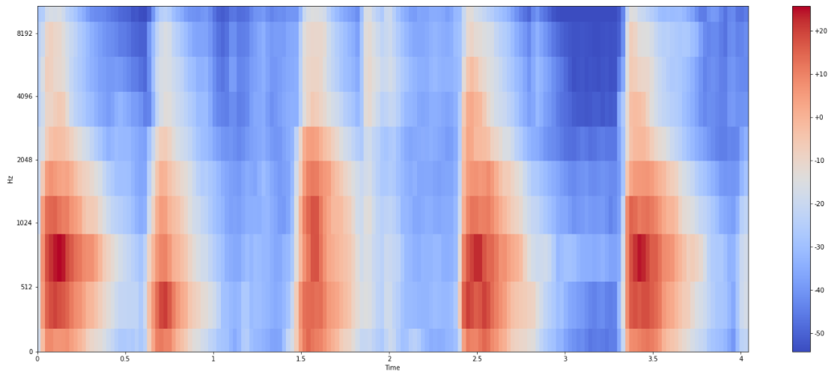
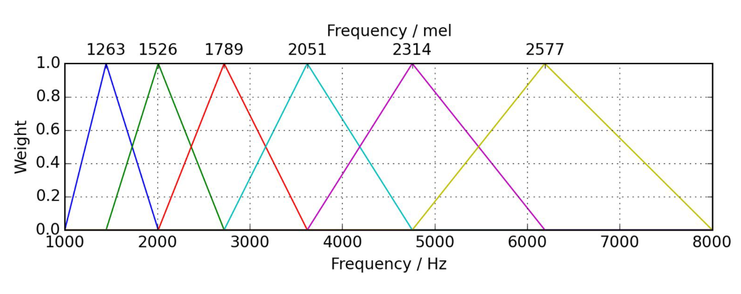
Spectral Features
5. Mel-Spectrograms (Contd.)
Extract STFT → Convert amplitude to dBs → Convert freq. to mel scale
Steps to extract this feature:
Choose # mel bands (depending on application)
Construct mel bands
1. Convert lowest/highest frequency to mel
2. Get equally spaced points, convert the mels to their respective frequencies and round off
3. Create triangular filters
Apply mel filter banks to spectrogram
Mel Spectrogram(#mel bands X #frames) = M(#mel bands X #freq. Bins ) @ Y(#freq. Bins X #frames)

Slide 19
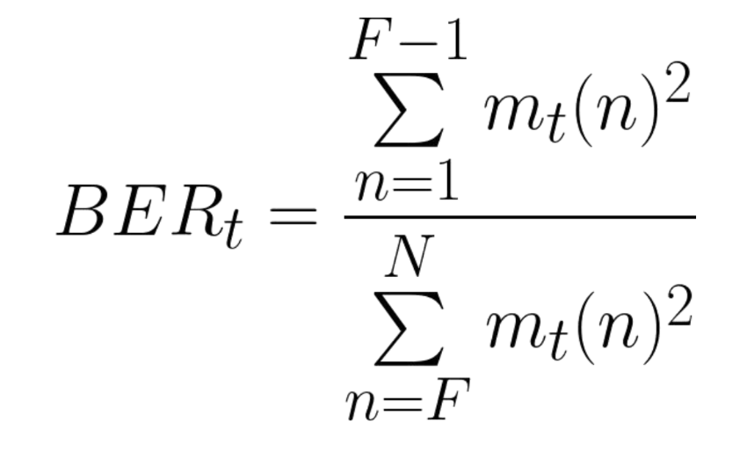
Spectral Features
6. Band Energy Ratio
Comparison of energy in lower/higher frequencies
Measure on how dominant low frequencies are

Slide 20
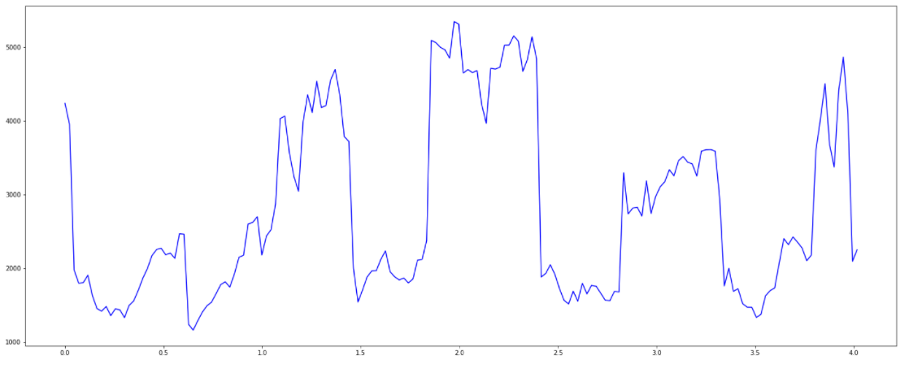
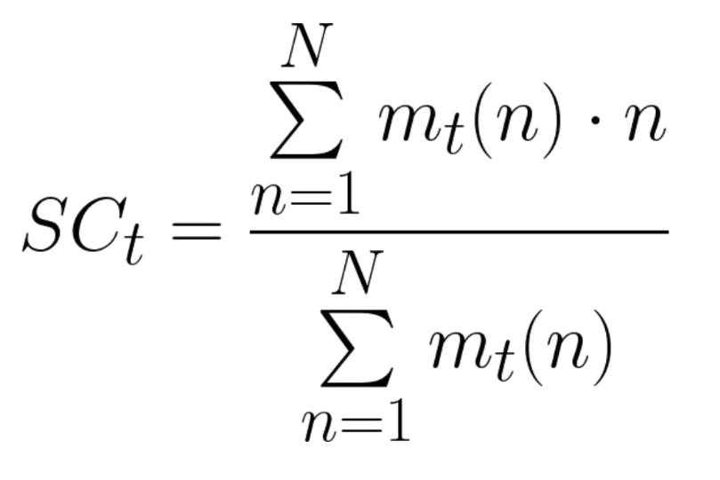
Spectral Features
7. Spectral Centroid
Center of gravity for magnitude spectrum
Frequency band where most of the energy concentrated
Measures brightness of sound

Slide 21
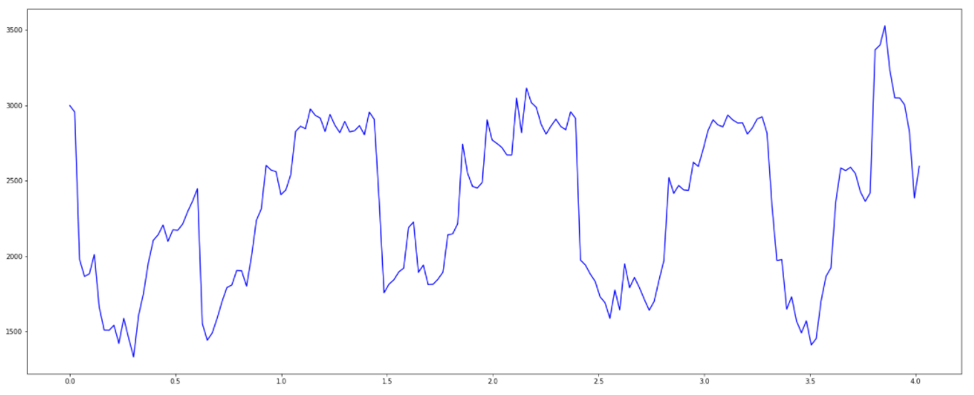
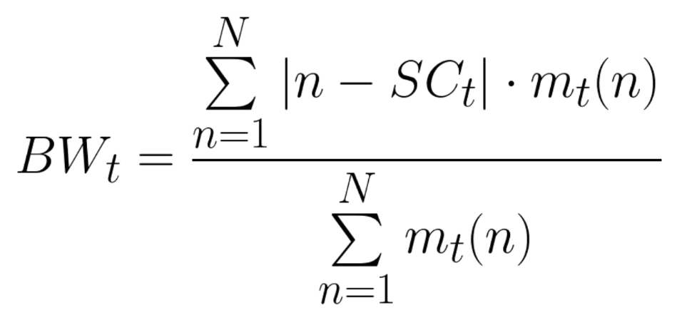
Spectral Features
8. Spectral Spread or Bandwidth
Measures variance from the spectral centroid
Weighted mean of the distances of frequency bands from spectral centroid
Energy spread across frequency bands → B.W.

Slide 22
Thank You!

